Slide 1
Chapter 6
Data Analysis with Cross-Tabulation

Slide 2
Learning Objectives
Explain the concept and components of cross-tabulation
Describe the advantage of using cross-tabulation
Demonstrate the steps used in SPSS for computing bivariate cross-tabulation
Describe the statistical inference through cross-tabulation
Explain the directional and symmetric measures in cross-tabulation

Slide 3
Execute and interpret row and column percentages in cross-tabulation
Explain the concept of controlling variables by analyzing one and two additional layering variables
Describe the statistics involved in cross-tabulation procedure
Visualize data in cross-tabulation

Slide 4
Cross-Tabulation
Cross-tabulation (also called crosstabs) represents the relationship among two or more categorical variables by controlling the layering variable in a sample data. Preparation of cross-tabulation is based on selecting the variables measured at nominal scale.
Components of Cross-Tabulation
 |  | Variable 2 |  |  |  |  | Row total
 |  | 2_{a} | 2_{b} | 2_{c} | 2_{d} | 2_{e}
Variable 1 | 1_{a}
 | 1_{b}
Column total |  |  |  |  |  |  | Grand total

Slide 5
Advantages of Using Cross-Tabulation
Cross-tabulation is used for analysing the relationship among two or more categorical variables based on nominal data.
It illustrates a simple table consisting of certain rows and columns representing frequencies (either in number or percentage) for entire sample data or subgroup of sample data.
It is used for comparing the frequencies of various levels among the variables for in-depth data analysis.
It is further used in contingency analysis to establish relationship among the variables on the basis of chi-square statistics (Chapter 18) to make statistical inferences for the target population.

Slide 6
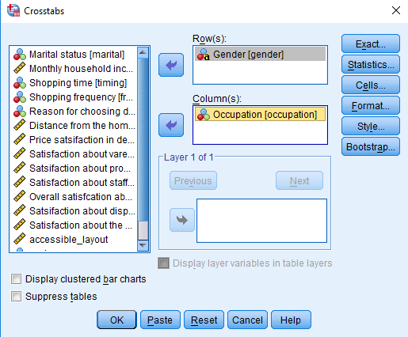
Frequency Analysis from Bivariate Cross-Tabulation
Exhibit 6.1. Use retail.sav » Menu bar » Analyse » Descriptive statistics » Crosstabs » Select Gender and transfer to Row(s) box » Select Occupation and transfer to Column(s) box » Click OK

Slide 7
Table 6.1. Cross-Tabulation (Gender × Occupation)
 | Occupation |  |  |  |  |  | Row Total
 |  | Business | Government Employee | Private Employee | Student | Housewife
Gender | M | 33 | 12 | 23 | 7 | 0 | 75
 | F | 3 | 10 | 8 | 9 | 15 | 45
Column total |  | 36 | 22 | 31 | 16 | 15 | 120

Slide 8
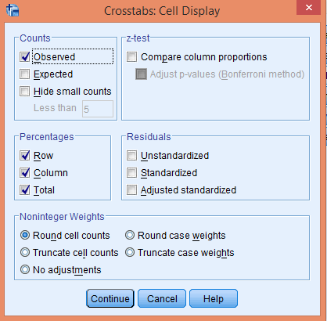
Computing Frequency in Row and Column Percentage
SPSS also computes observed frequencies in percentage for respective rows and columns. Interpretation of Crosstabs depends on the assumption of variables as dependent or independent along with the exhibits in the corresponding row and column particularly.

Slide 9
Simple Cross-Tabulation (Gender × Saving attitude) Representing Frequencies in Percentage
 |  |  | Saving Attitude of the Customer |  | Total
 |  |  | Yes | No
Gender | Male | Count (OF*) | 15 | 60 | 75
 |  | % within gender | 20.0% | 80.0% | 100.0%
 |  | % within saving attitude | 34.9% | 77.9% | 62.5%
 |  | % of total | 12.5% | 50.0% | 62.5%
 | Female | Count (OF*) | 28 | 17 | 45
 |  | % within gender | 62.2% | 37.8% | 100.0%
 |  | % within saving attitude | 65.1% | 22.1% | 37.5%
 |  | % of total | 23.3% | 14.2% | 37.5%
Total |  | Count (OF*) | 43 | 77 | 120
 |  | % within gender | 35.8% | 64.2% | 100.0%
 |  | % within saving attitude | 100.0% | 100.0% | 100.0%
 |  | % of total | 35.8% | 64.2% | 100.0%

Slide 10
Tables in Cross-Tabulation
Cross-Tabulation with One Additional Layering Variable
We use Crosstabs option consisting of three boxes, that is, row(s), column(s) and Level 1 of 1 to ascertain the frequencies of different combinations of categorical variables (gender and saving attitude) with four levels of income groups.
Exhibit 6.2. Use retail.sav » Menu bar » Analyze » Descriptive statistics » Crosstabs » Select Gender and transfer to Row(s) box » Select saving and transfer to Column(s) box » Select income and transfer to Layer 1 of 1 box » Click OK

Slide 11
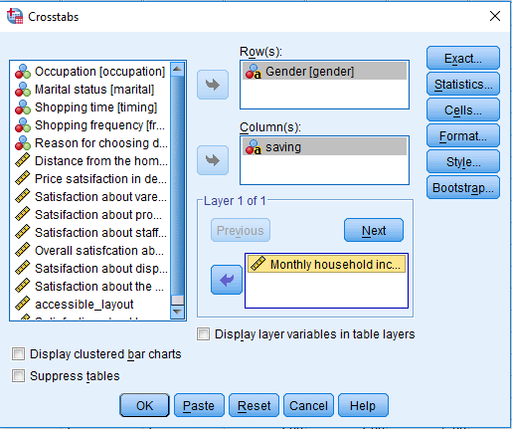

Slide 12
Cross-Tabulation: One Additional Variable Income
Categories (Independent Variable) |  | Saving Attitude |  | Total | Categories (Independent Variable) |  | Saving Attitude |  | Total
 |  | Yes | No |  |  |  | Yes | No
<10000* | Male Female | 7 | 6 | 13 | 30001–40000 | Male Female | 3 | 21 | 24
 |  | 12 | 2 | 14 |  |  | 4 | 3 | 7
 | Total | 19 | 8 | 27 |  | Total | 7 | 24 | 31
10001–20000 | Male Female | 2 | 8 | 10 | >40000 | Male Female | 1 | 12 | 13
 |  | 4 | 3 | 7 |  |  | 6 | 3 | 9
 | Total | 6 | 11 | 17 |  | Total | 7 | 15 | 22
20001–30000 | Male Female | 2 | 13 | 15 | Total | Male Female | 15 | 60 | 75
 |  | 2 | 6 | 8 |  |  | 28 | 17 | 45
 | Total | 4 | 19 | 23 |  | Total | 43 | 77 | 120
*Monthly income in Indian Rupees (INR).

Slide 13
Statistics Associated with Cross-Tabulation
Chi-square Statistic: Chi-square statistic is applicable to ascertain whether the variables are independent to each other or not. It also measures the association between the cross-tabulated variables.
Exhibit 6.3. Use retail.sav » Menu bar » analyse » Descriptive statistics » Crosstabs » Select Gender and transfer to Row(s) box » Select frequency and transfer to Column(s) box » Statistics » (select) Chi-square » Continue » Cells » (select) Expected » Continue » Click OK

Slide 14
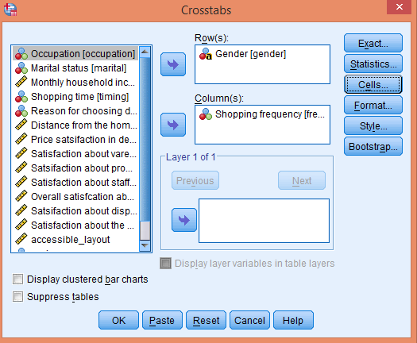
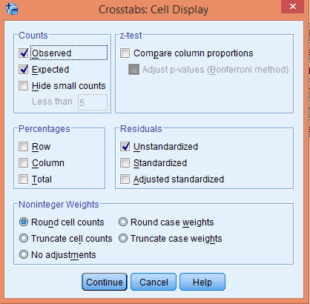

Slide 15
Statistical Significance of Cross-Tabulation
Observed and Expected Frequency
 |  |  | Shopping Frequency |  |  |  |  | Total
 |  |  | First Time | Monthly | Weekly | More than a Week | Not Fixed
Gender | Male | OF | 18 | 10 | 23 | 18 | 6 | 75
 |  | EF | 13.8 | 11.9 | 24.4 | 18.8 | 6.3 | 75.0
 |  | Residual | 4.3 | −1.9 | −1.4 | −0.8 | −0.3
 | Female | OF | 4 | 9 | 16 | 12 | 4 | 45
 |  | EF | 8.3 | 7.1 | 14.6 | 11.3 | 3.8 | 45.0
 |  | Residual | −4.3 | 1.9 | 1.4 | 0.8 | 0.3
Notes: EF: Expected frequency; OF: Observed frequency.

Slide 16
Table 6.2. Chi-square Statistics
 | Value | df | Sig. (2-sided)
Pearson chi-square | 4.606 | 4 | 0.330
Likelihood ratio | 4.983 | 4 | 0.289
Linear-by-linear association | 1.494 | 1 | 0.222
The p-value is greater than 0.05 (Chi-square = 4.606, p > 0.05, 0.330) at 5 % level of significance.
We fail to reject the null hypothesis of the independent relationship between the variables and conclude that no relationship exists between the variables.

Slide 17
Correlation and Measurers of Association
Correlation is often used to measure the association between metric variables. The strength of association between nominal based cross-tabulated variables is required task in the analysis.
Exhibit 6.4. Use retail.sav » menu bar » analyse » descriptive statistics » Crosstabs » Select saving and transfer to row (s) box » Select gender and transfer to column (s) box » cells » select observed in count area » select row, column and total as percentage area » Statistics » (select) contingency coefficient, Phi and Cramer’s V, Lambda, Uncertainty coefficient » Continue » Click OK

Slide 18
Table 6.3 Cross-Tabulation Saving and Gender
 |  |  | Gender |  | Total
 |  |  | male | female
Saving | Yes | Count | 15 | 28 | 43
 |  | % within saving | 34.9% | 65.1% | 100.0%
 |  | % within gender | 20.0% | 62.2% | 35.8%
 |  | % of total | 12.5% | 23.3% | 35.8%
 | No | Count | 60 | 17 | 77
 |  | % within saving | 77.9% | 22.1% | 100.0%
 |  | % within gender | 80.0% | 37.8% | 64.2%
 |  | % of total | 50.0% | 14.2% | 64.2%
Total |  | Count | 75 | 45 | 120

Slide 19
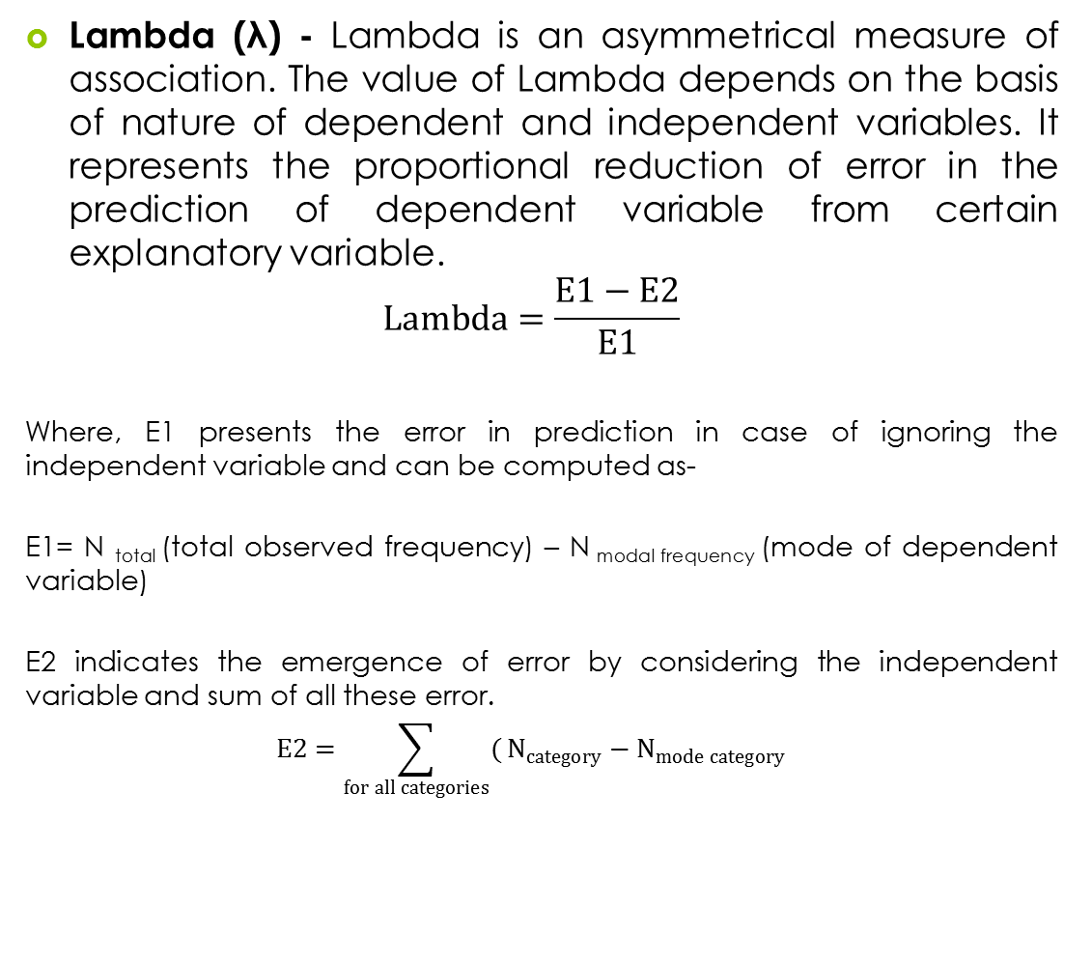
Directional Measures

Slide 20
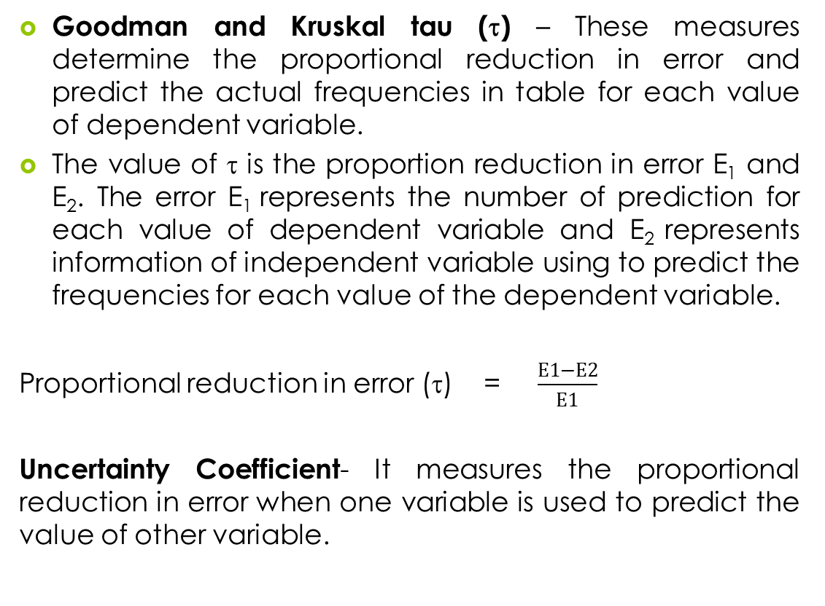

Slide 21
 |  |  | Value | Asymp. Std. Errorª | Approx. T^{b} | Approx. Sig.
Nominal by nominal | Lambda | Symmetric | 0.273 | 0.120 | 2.034 | 0.042
 |  | Saving dependent | 0.256 | 0.135 | 1.658 | 0.097
 |  | Gender dependent | 0.289 | 0.123 | 2.016 | 0.044
 | Goodman and Kruskal tau | Saving dependent | 0.182 | 0.073 | – | 0.000
 |  | Gender dependent | 0.182 | 0.073 | – | 0.000
 | Uncertainty coefficient | Symmetric | 0.139 | 0.057 | 2.425 | 0.000
 |  | Saving dependent | 0.140 | 0.057 | 2.425 | 0.000
 |  | Gender dependent | 0.138 | 0.057 | 2.425 | 0.000

Slide 22
Asymmetric Lambda value (0.25) is computed, when saving (row, λ_{R}) variable is considered as a dependent variable. We can say that proportion of error in saving is reduced by 25% when gender is considered as independent variable. The value of Lambda is changed to 0.289 when gender (column, λ_{C}) is considered as a dependent variable. In this view, the value of symmetric Lambda lies between λ_{R} and λ_{C.} and is computed as 0.273.

Slide 23
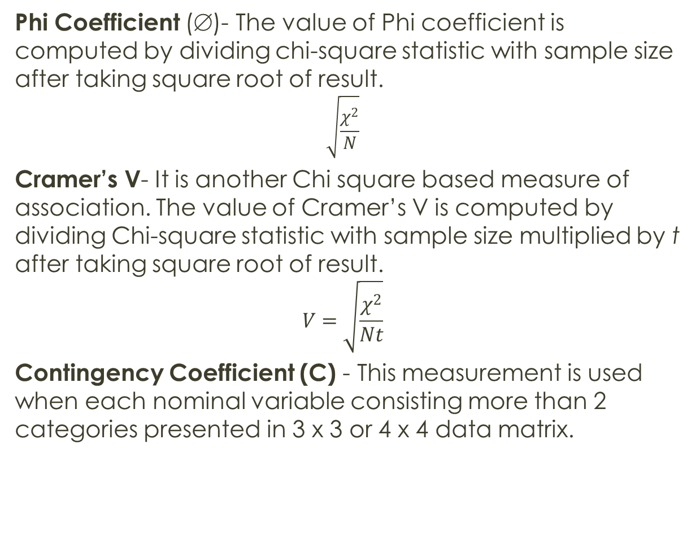
Symmetric Measures

Slide 24
 |  | Marital Status × Shopping Frequency |  | Marital Status × Shopping time
Statistics |  | Value | p-value | Value | p-value
Nominal by nominal | Phi | 0.261 | 0.085 | 0.286 | 0.044
 | Cramer's V | 0.261 | 0.085 | 0.286 | 0.044
 | Contingency coefficient | 0.253 | 0.085 | 0.275 | 0.044
 | Pearson chi-square | 8.18 | 0.085 | 9.810 | 0.044
The results indicate a weak association between marital status and shopping frequency and also non-significant at 5% LoS due to higher p-value (p > 0.05, 0.085).
The association of marital status with shopping time is significant due to lower p-value (p < 0.05, 0.04) along with higher Phi value 0.286.

Slide 25
Visualizing Data in Cross-Tabulation
Binary Cluster Bar Chart: The crosstabs in SPSS also prepare clustered bar chart for displaying the frequencies of combination of categories of one variable to the other.
Exhibit 6.5. Use retail.sav » Menu bar » analyse » Descriptive statistics » Crosstabs » Select Gender and transfer to Row(s) box » Select Saving and transfer to Column(s) box » Select Display Cluster Bar Charts » Continue » Click OK

Slide 26
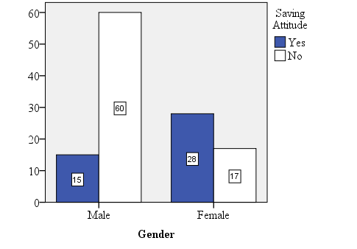

Slide 27
Multiple Cluster Bar Chart
The multiple bar chart displays more than two variables in a single graph.
Exhibit 6.6. Use retail.sav » Menu bar » analyse » Descriptive statistics » Crosstabs » Select Marital and Saving and transfer to Row(s) box » Select Gender and transfer to Column(s) box » Select Display Cluster Bar Charts » Continue » Click OK

Slide 28
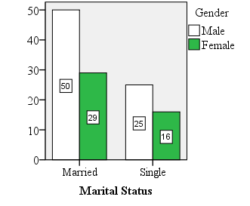
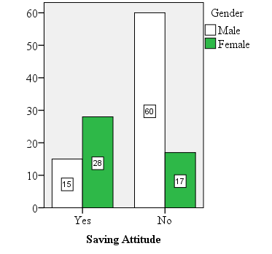
Figure 6.1a. Cluster Bar Chart: Marital
Figure 6.1b. Cluster Bar Chart: Saving

Slide 29
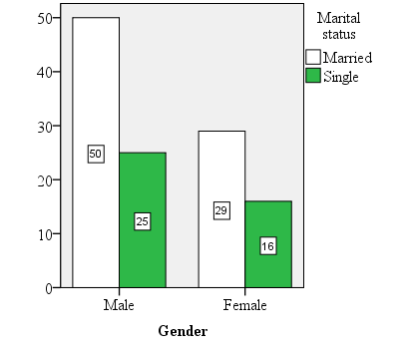
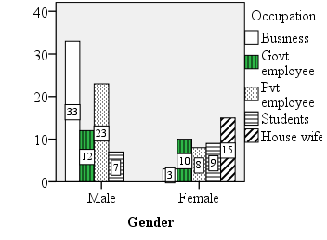
Multiple Cluster Bar Chart
Exhibit 6.7. Use retail.sav » Menu bar » analyse » Descriptive statistics » Crosstabs » Select Gender and transfer to Row(s) box » Select Marital and Occupation and transfer to Column(s) box » Select Display Cluster Bar Charts » Continue » Click OK
Figure 6.2a. Cluster Bar Chart: Marital Status
Figure 6.2b. Cluster Bar Chart: Occupation

Slide 30
Scale Requirements for Cross-Tabulation
Task | Number of Variables Required | Pattern of Displaying the Variables | Required Scale
Bivariate cross-tabulation | 2 | Categories of one variable arranges column-wise and second row-wise | Both are nominal and have more than two categories
Cross-tabulation with one layering variable | 3 | Two main variables at rows and columns and control variable divides the table into certain panels | All the three variables are nominal and have more than two categories
Crosstabs Statistic
Chi-square statistic | 2 | Variables display in the form of contingency table (2 × 2 tables) | Both are nominal and have more than two categories
Measures of association
Lambda | 2 | Variables display in the form of contingency table (2 × 2 tables) | Both are nominal in nature
Goodman and Kruskal tau
Uncertainty coefficient
Phi | 2 | Variables display in the form of contingency table (2 × 2 tables) | Both are nominal in nature
Cramer's V | 2 | Contingency table with unequal number of rows and columns present (3 × 4 or 4 × 5)
Contingency coefficient | 2 | Contingency table with equal number of rows and columns present (3 × 3 or 4 × 4)

Slide 31
Key Terms
Box plot Confidence interval Normal probability plot (P-P and Q-Q) Outliers Point estimation | Population parameter Stem and Leaf plot Test statistics Trimmed mean Z -score

